Slide 1



Amazon Food Reviews BAN 200 NBB Project
Group 8
Pruthviben Jaimin Patel
Pratik Andrade
Ronn Kurien Kollamana
Laher Gregory Pereira

Slide 2
Table of Contents
Approach and analysis
03
References
07
Graphs and visualizations
04
Conclusion
06
Goal – what problem are we trying to solve?
01
Data description
02
Training and testing a model
05

Slide 3

Goals of this Project
Identifying helpfulness of reviews using Text Analytics
Are there any trends in the review scores?
Develop a model to predict the sentiment of the review
Implementing the concepts of Text mining, classification and sentiment analysis that we have learned in the course

Slide 4
Introduction to the Project
Finding the sentiments from text reviews using sentiment analysis.
Understanding the reviews in terms of helpfulness, length of reviews, and identifying the top reviewers.
Carrying out topic modelling to categorize the reviews based on their food class.
Creating visualizations to ease the understanding of reviews.
Sentiment analysis is carried out using neural networks and LDA algorithm is used for topic modelling.

Slide 5

Data Description
The dataset that we have used for this project is the Amazon Food Reviews Dataset: https://www.kaggle.com/snap/amazon-fine-food-reviews
The dataset is taken from Kaggle and contains more than 10 features and over 500,000 observations.
It includes reviews about food purchases from Oct 1999 to Oct 2012
This is an easy-to-understand dataset and includes essential meta data for the purpose of this project.
The information includes product and user information, ratings and reviews in plain text.

Slide 6
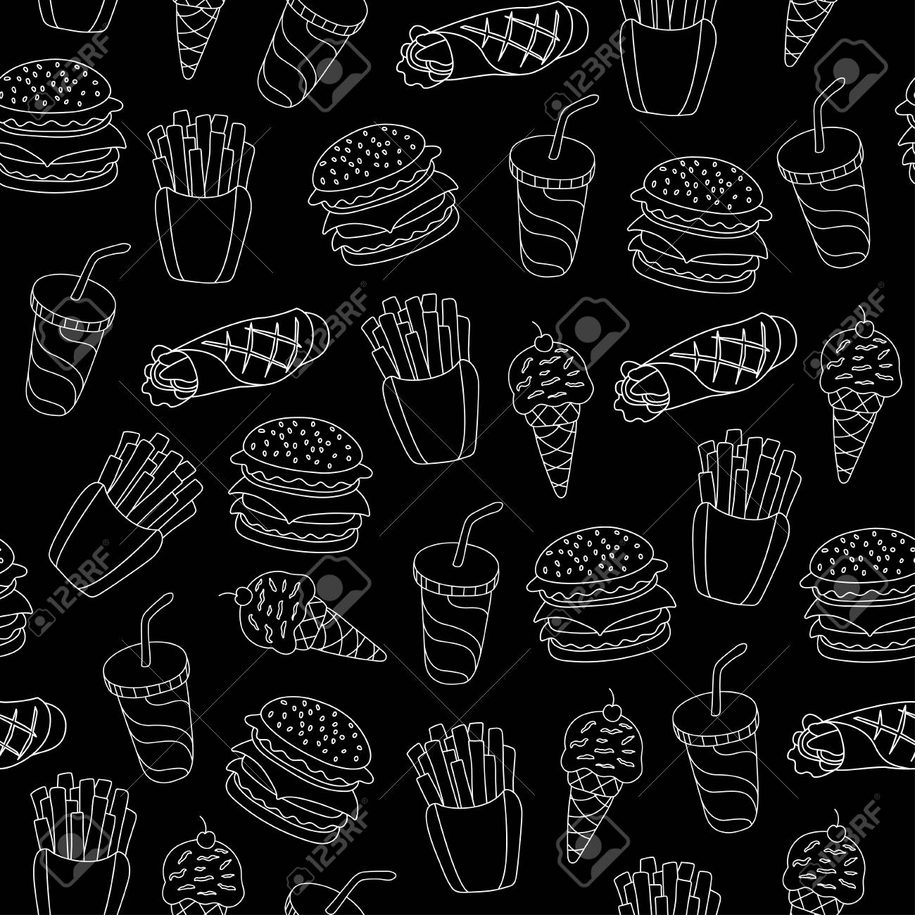
Data Description
Column | Description
ID | Row ID
ProductId | Unique identifier for the product
UserId | Unqiue identifier for the user
ProfileName | Profile name of the user
HelpfulnessNumerator | Number of users who found the review helpful
HelpfulnessDenominator | Number of users who indicated whether they found the review helpful or not
Score | User rating between 1 and 5
Time | Timestamp for the review
Summary | A brief summary of the review
Text | Complete text of the review

Slide 7
Approach and Analysis
Importing Libraries
Importing the dataset and displaying the first five rows
Displaying some statistical insights of the dataset
Sample review from the dataset
Data preprocessing : Cleaning and calculating review lengths
Generating a word cloud to find out the most frequent words
Classifying the reviews into positive and negative

Slide 8
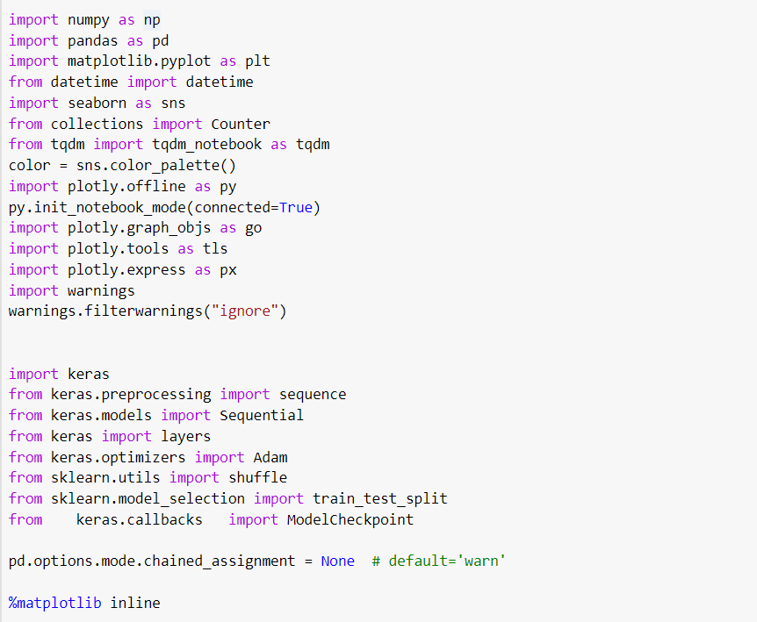
Importing essential libraries

Slide 9
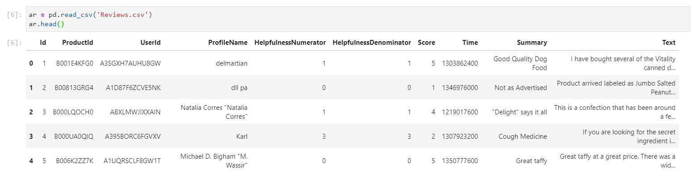
Importing the dataset and displaying the first five rows

Slide 10
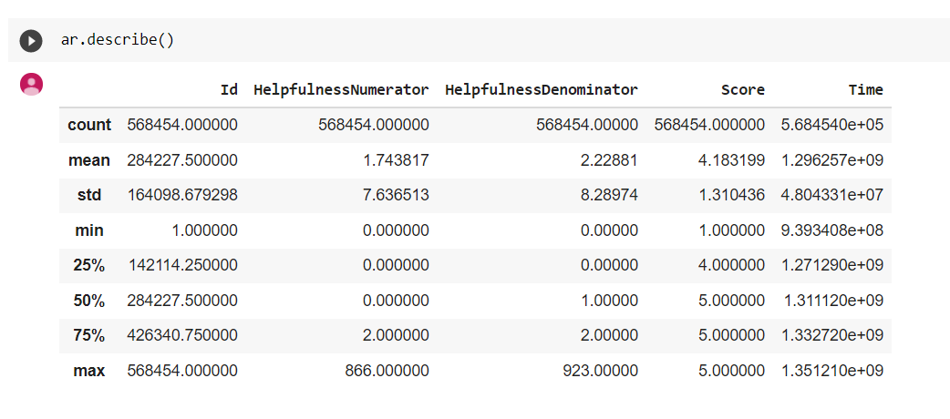
Displaying some statistical insights of the dataset

Slide 11
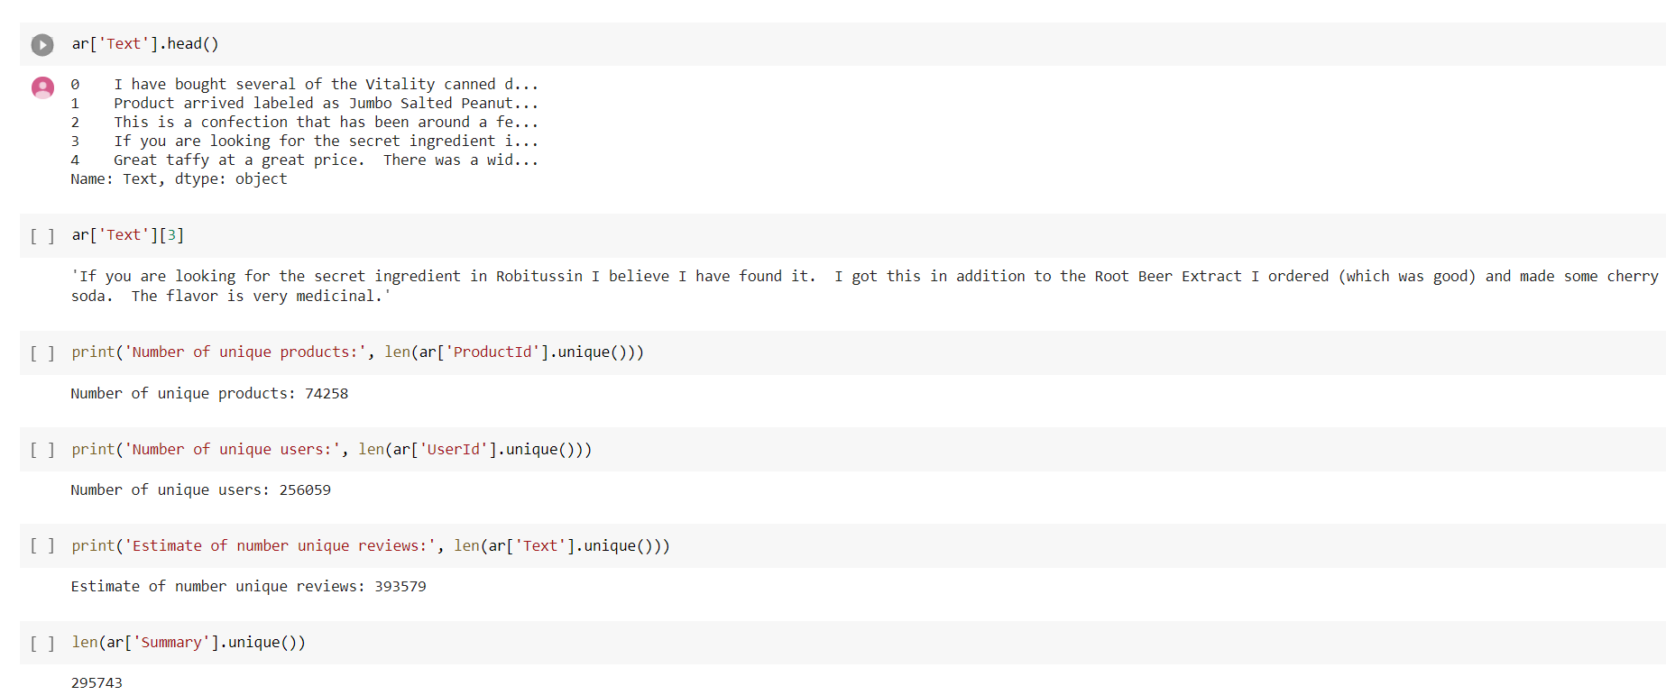
Sample review from the dataset

Slide 12
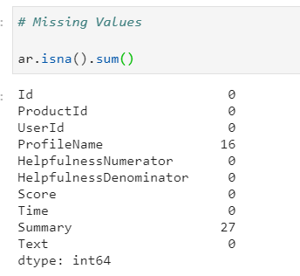
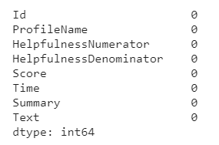
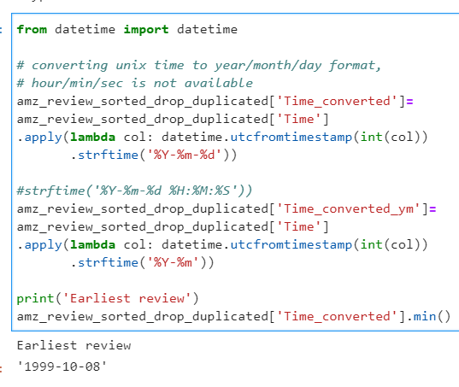
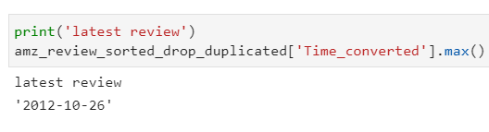
Data preprocessing - Cleaning
Spotting missing records in the dataset and removing them
Earliest and latest review dates

Slide 13
Cleaning the text of reviews
Removing partially scraped containing HTML headers like (</span>), and transforming the text to lower case for consistency.
Removing special characters (e.g. "{$1?&") from the text
Removing extra space, parsing the data
Removing stopwords (e.g. " he, she, is, the,..."), keep reviews with at least 3 word
Removing NaN (very few)

Slide 14
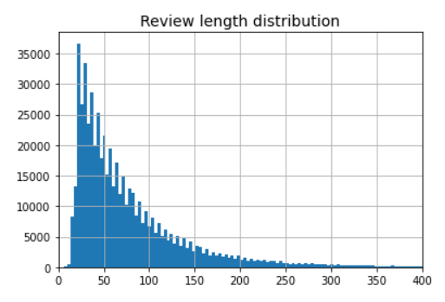
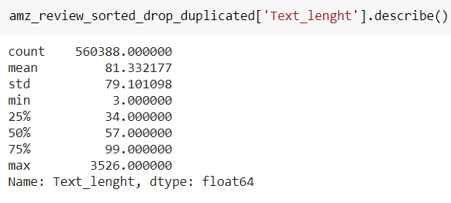
Calculating review lengths
Length of review is calculated (after cleaning) to understand impact of more in depth content on its helpfulness
Reviews on average have about 80 words, very small less than 1% go beyond 400 words

Slide 15
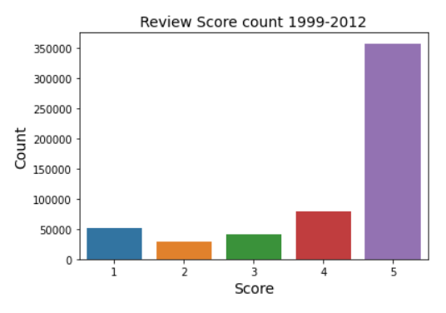
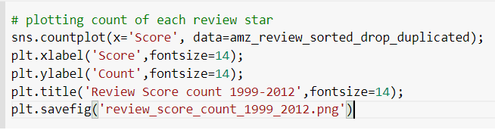
Plotting the review score
It was observed that the number of 5 star ratings were considerably higher than the rest. This was followed by 4 stars and then a lowest rating of 1 star.

Slide 16
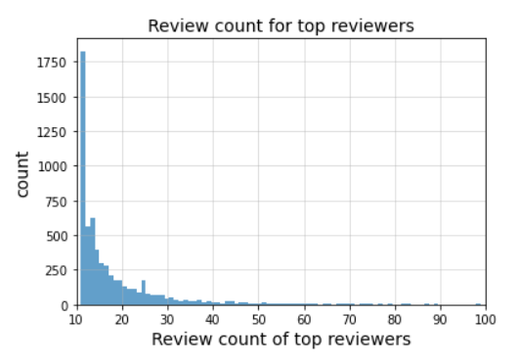
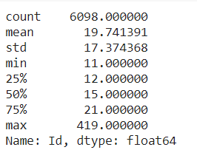
Grouping reviews together
Users with more than 10 reviews are put in the top group
The following is a distribution of review count per user for top reviewers

Slide 17
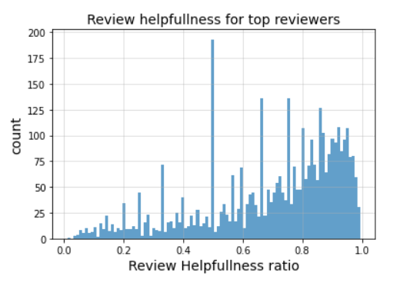
Calculating the helpfulness of the reviews
Ratio helpfulness = HelpfulnessNumerator / HelpfulnessDenominator
The following is a distribution of helpfulness for top reviewers

Slide 18
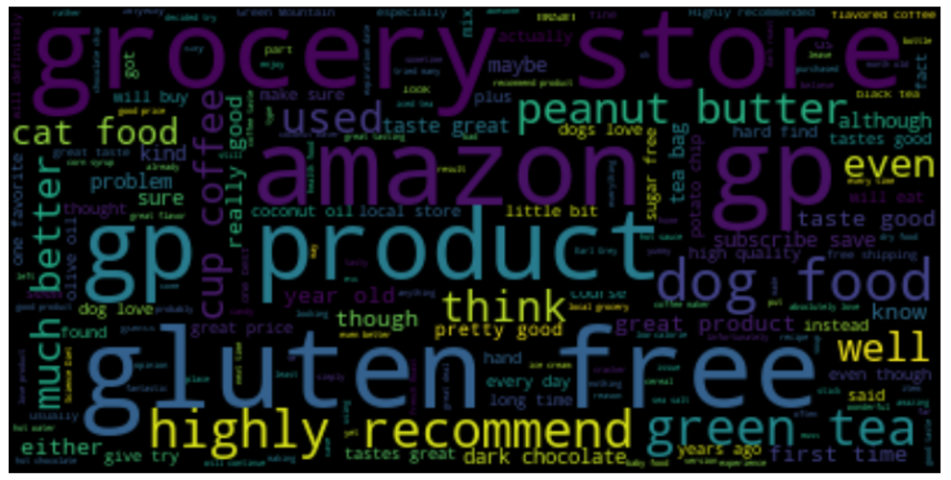
Generating a Wordcloud
The following Wordcloud shows the most frequent words that appear in the reviews
We can observe that most reviews are targeted on Gluten free products, dog/cat food, green tea, groceries and peanut butter

Slide 19
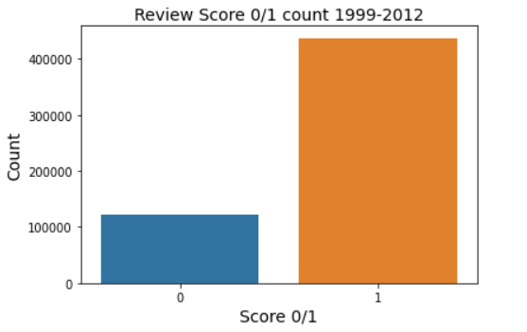
Classifying reviews into positive and negative based on score
The reviews are grouped into two categories.
If the score is greater than 3 then we categorize them as group 1 (pos) else group 0 (neg).
As we can see from the bar chart, more than 400000 reviews have a positive score.

Slide 20
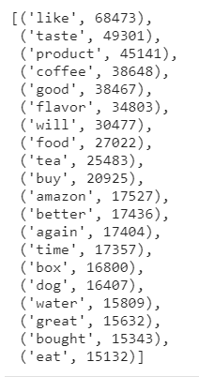
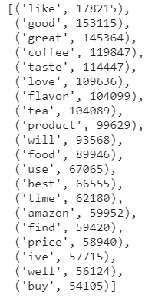
Top 20 negative and positive words from the reviews

Slide 21
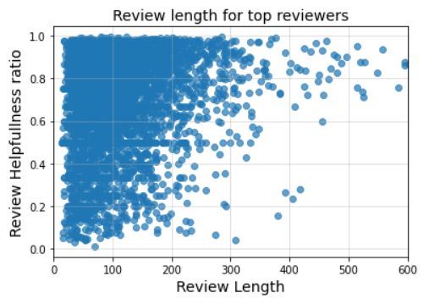
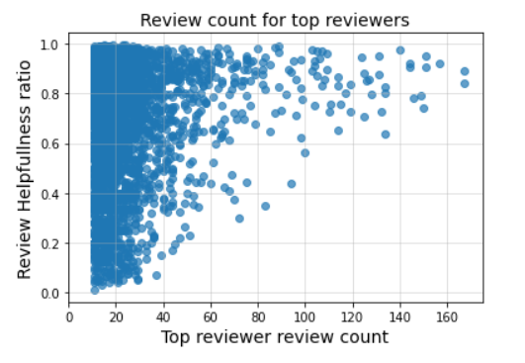
Some graphs and visualizations using the matplotlib library
Review length vs Review Helpfulness : Reviews between 20 to 250 words were found to be more helpful
Review count vs Review Helpfulness : It was observed that the top reviewers had around 10 to 60 reviews which were found to be most helpful

Slide 22
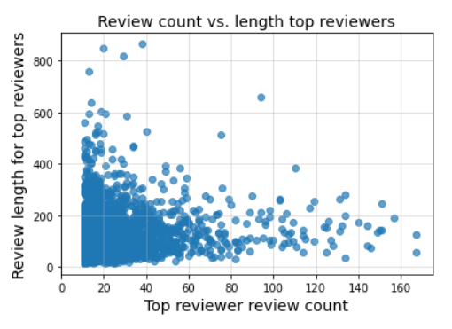
Some graphs and visualizations using the matplotlib library
Review count vs Review length of top reviewers :
As we can see from the scatterplot, most of the data is concentrated in the bottom left corner.
Top reviewers had a review length between 10 to 400 words and a frequency of 10 to 60 reviews.

Slide 23
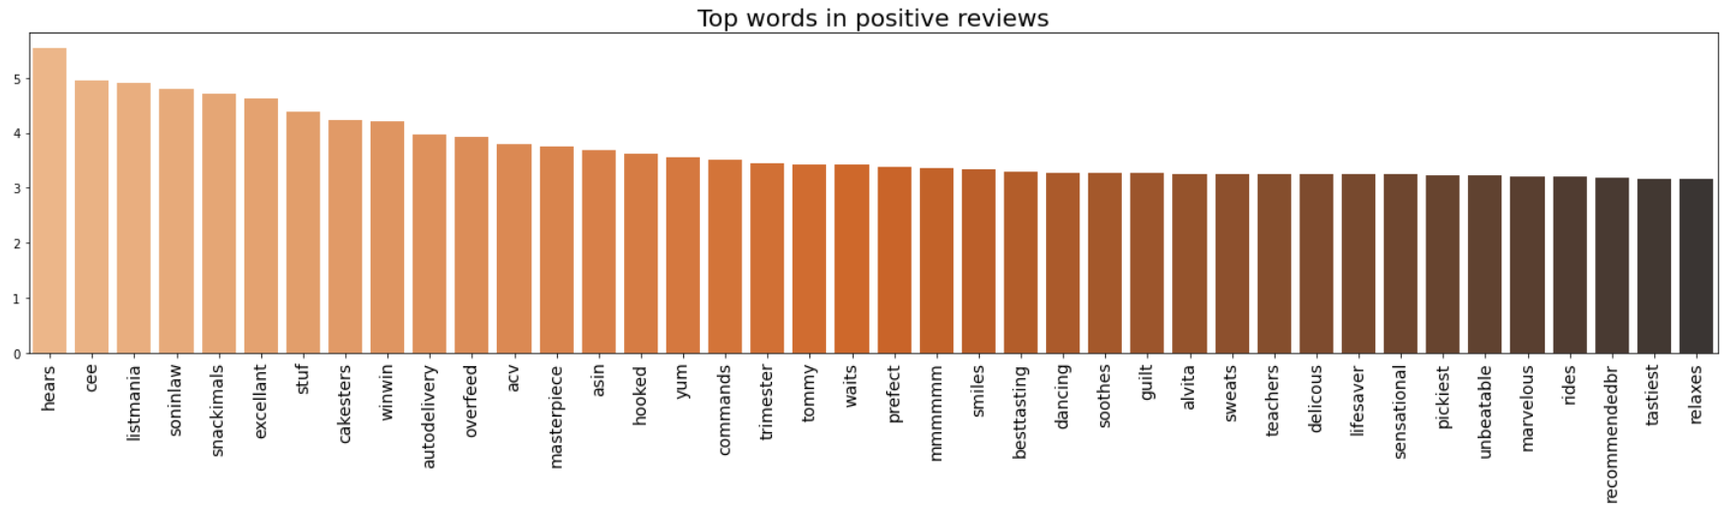
Top words in positive reviews Some common sentiments include excellent, auto delivery, perfect, delicious, recommended and more

Slide 24
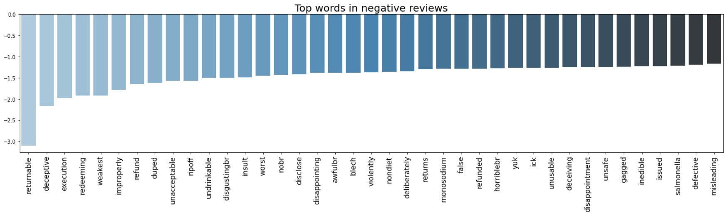
Top words in negative reviews Some common sentiments include horrible, unusable, disappointed, returnable and more

Slide 25
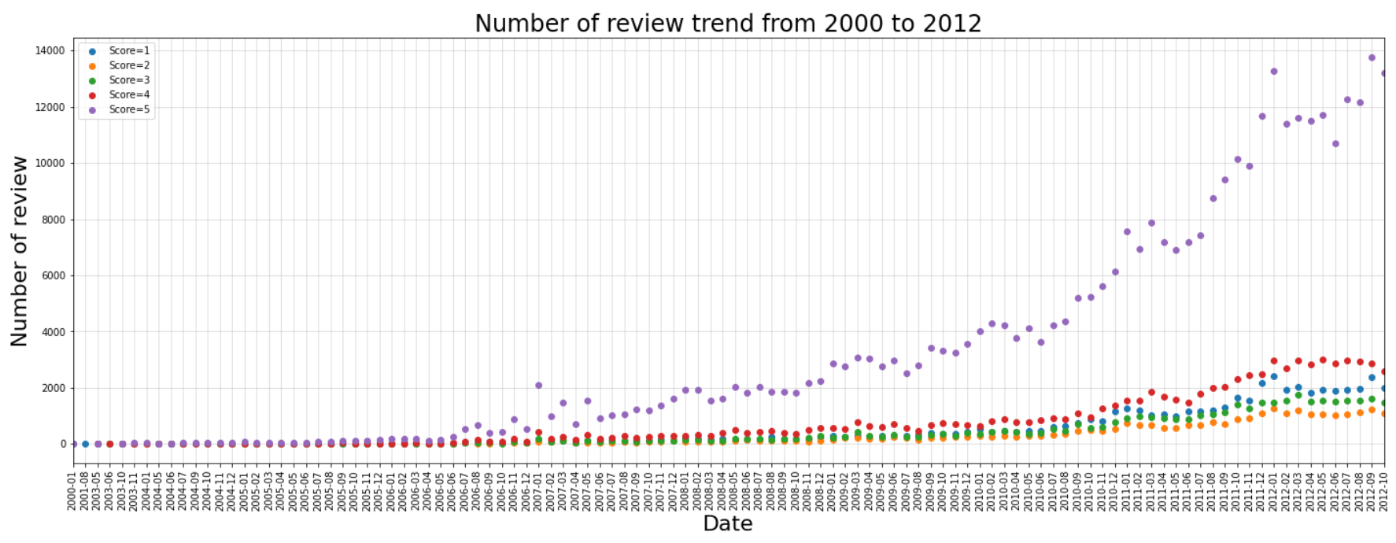
We can see an increase in the number of 5 star ratings from July 2006 onwards

Slide 26
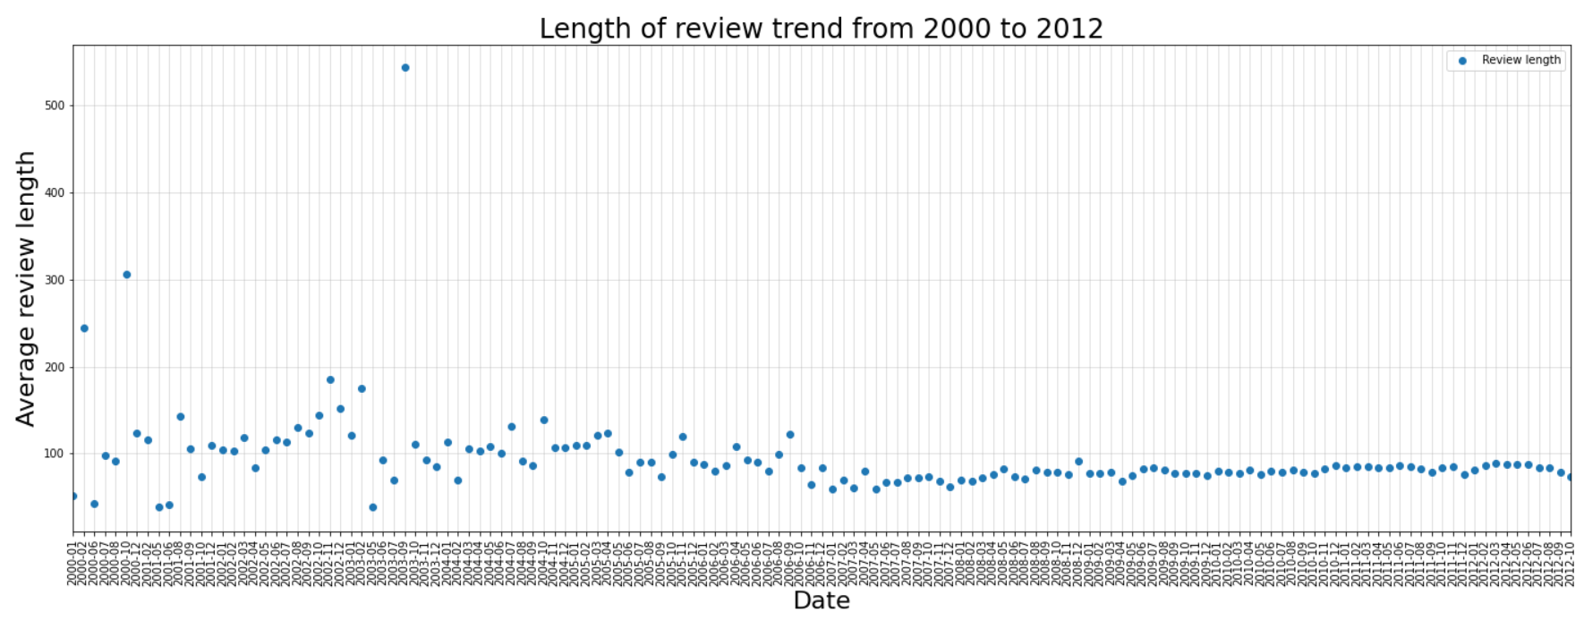
The length of the reviews has been more or less the same throughout the years.

Slide 27
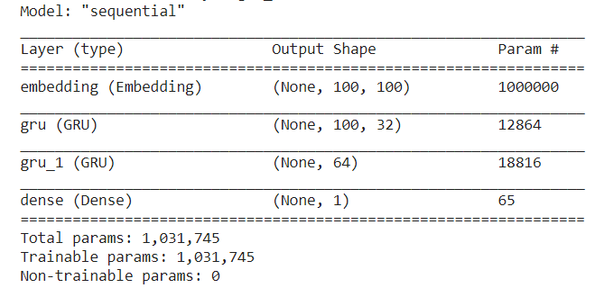
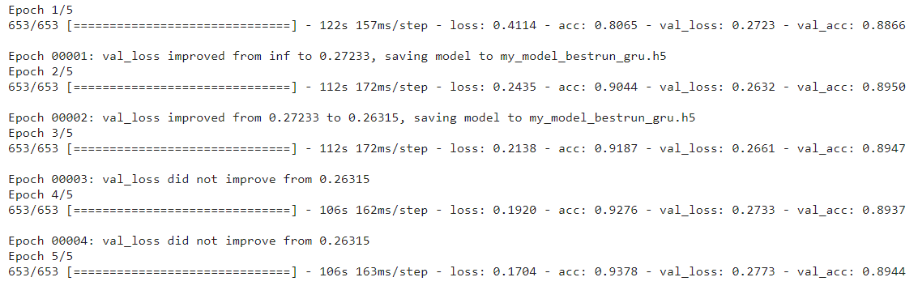
Training The Neural Network Model
The three layer neural network model is created with one sigmoid layer for the output.
We split the data into training and testing set with 20% validation data,
Hyper Parameters:
Batch size-128
Epochs – 5
Learning Rate – 0.001
Drop out- 0.1
Activation function – tanh / Sigmoid (binary)
Optimizer - Adam
The number of epochs as shown in the image shows the number of iterations/passes that is done on the entire dataset.

Slide 28
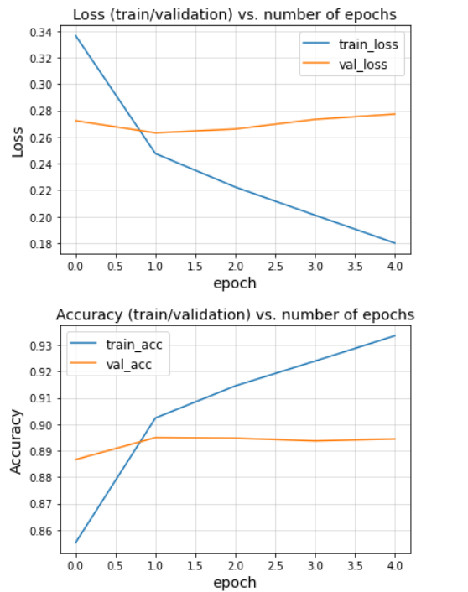
Loss and Accuracy
As shown in the image, the training loss goes down as we increase the number of iterations, however the validation loss remains between 0.26 to 0.28.
Our model performs well with the training data however since validation loss > training loss our model is slightly overfitting.
Accuracy is above 93% after 4 iterations on the training set and has an validation accuracy of 89%.

Slide 29
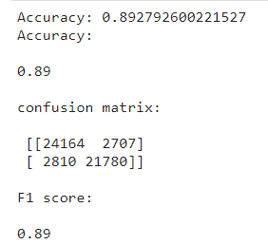
Accuracy Measures
The confusion matrix shows the following data:
TP (24164), FP(2707), FN(2810), TN(21780).
Accuracy of the model on the testing data is 89%, which shows that our model is performing well.

Slide 30
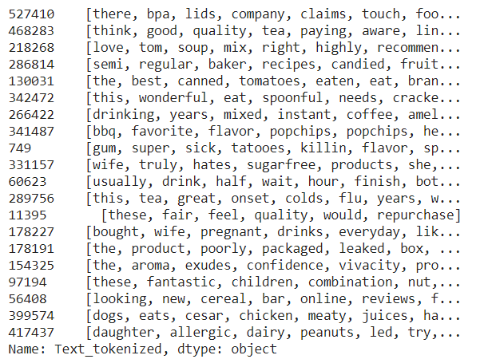
Topic Modelling
In order to understand the reviews better, we tried to categorized them.
Based on the review, which kind of food class it is we tried to identify them.
Latent Dirchlet Allocation(LDA) algorithm is used for that.
We have done tokenization using genesim library and then trained ldamulticore model.

Slide 31
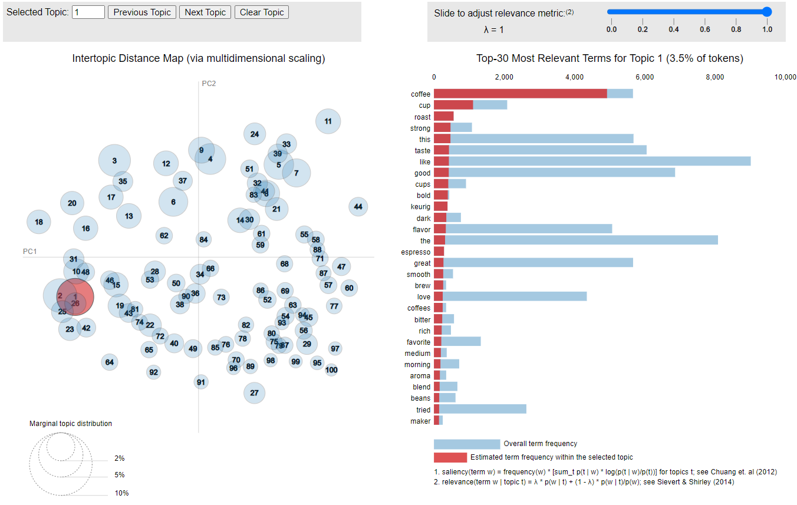
Interactive visualization for topic modelling using PyLDA package
(The interactive version attached with the presentation)

Slide 32
Conclusion
On the basis of our analysis we can deduce that there are two main types of reviewers that share helpful and meaningful insights with the community and can be considered as reliable.
The first group consist of reviewers that write long detailed reviews and the second group consist of reviewers that share frequent short reviews on the same platform.
A sudden increase in 5 star reviews for certain products could be considered as fake addition of reviews.
Using LDA topic modelling we were able to identify the most popular food items from the top reviewers

Slide 33
Conclusion
As observed, a simple neural network with forward propagation (sequential modelling) can help predict the sentiment of reviews using the text with a good accuracy rate.
Amazon has introduced a features called 'verified accounts' and 'vine programs' to restrict fake reviews on their platform. However, these are not trustworthy yet.
Using advanced analysis techniques in the future, there is a good scope in verifying the programs that check for accuracy of the reviews received online. This will help the customers read only legit reviews and help them make a good purchase online.

Slide 34
References
Dataset: https://www.kaggle.com/snap/amazon-fine-food-reviews
Notebook is available at : https://colab.research.google.com/drive/1KgGm5gMyaRTzGGe4yemFK-Uc0nWH3j0N?usp=sharing#scrollTo=gt1PYnvlnKQI
https://towardsdatascience.com/text-mining-and-sentiment-analysis-for-yelp-reviews-of-a-burger-chain-6d3bcfcab17b
https://medium.com/@anoosheh.niavarani.egr/what-an-amazon-fine-food-review-tell-us-a-food-for-thought-869dfe70f2ee
https://towardsdatascience.com/sentiment-analysis-on-amazon-reviews-45cd169447ac

Slide 35
THANK YOU

